Slide 1

Departemen Statistika
Fakultas Matematika dan Ilmu Pengetahuan Alam
Institut Pertanian Bogor
Pemodelan Klasifikasi Pertemuan #8 DISKRETISASI
Bagus Sartono bagusco@apps.ipb.ac.id
2020

Slide 2
Outline
Pendahuluan dan Motivasi
Pengelompokan Metode Diskretisasi
Unsupervised Discretization
Supervised Discretization

Slide 3
Pendahuluan
Data terdiri atas banyak variabel dengan berbagai format/tipe:
Numerik diskret
Numerik kontinu
Kategorik ordinal
Kategorik nominal
Variabel yang bertipe numerik dapat diubah menjadi kategorik (ordinal) → prosesnya dikenal sebagai diskretisasi, ada juga yang menyebut sebagai binning
Diskretisasi ini sering membantu dalam pemodelan prediktif

Slide 4
Diskretisasi
Andaikan dataset berisi N observasi, proses diskretiasi terhadap variabel numerik A adalah mengubah nilai variabel tersebut menjadi m interval D = {[d₀, d₁], (d₁, d₂], …, (d_{m−1}, d_{m}]}, dengan d₀ adalah nilai terkecil, d_{m} adalah nilai terbesar, dan d_{i} < d_{i+i}, untuk i = 0, 1, ...,m−1.

Slide 5
Diskretisasi
6.58
15.35
14.24
6.22
1.82
2.11
13.77
5.65
15.58
12.46
13.05
11.64
10.91
14.31
7.42
X ≤ 5
5 < X ≤ 10
10 < X ≤ 15
X > 15

Slide 6
Motivasi
Without data discretization some rules would be difficult to establish.
Several existing data mining systems cannot handle continuous variables without discretization.
Data discretization significantly improves the quality of the discovered knowledge.
New methods of discretization needed for tables with rare events.
Data discretization significantly improves the performance of data mining algorithms. Some studies reported ten fold increase in performance. However:
Any discretization process generally leads to a loss
of information. Minimizing such a possible loss is the mark
of good discretization method.

Slide 7
Merging
Supervised
ChiMerge
Diskretisasi
Un-Supervised
Equal Width
Equal Freq
Splitting
Supervised
Tree/MDLP

Slide 8
Unsupervised Discretization

Slide 9
Equal Width dan Equal Frequency
In equal width, the continuous range of a feature is divided into intervals that have an equal width and each interval represents a bin. The arity can be calculated by the relationship between the chosen width for each interval and the total length of the attribute range.
In equal frequency, an equal number of continuous values are placed in each bin. Thus, the width of each interval is computed by dividing the length of the attribute range by the desired arity.

Slide 10
x <- c(15, 4, 21, 11, 16, 18, 24, 26, 28)
library(classInt)
#equal width
eqwid <- classIntervals(x, 4, style = 'equal')
eqwid$brks
x.eqwid <- cut(x, breaks=eqwid$brks, include.lowest=TRUE)
cbind(x, x.eqwid)
> eqwid$brks
[1] 4 10 16 22 28
> cbind(x, x.eqwid)
x x.eqwid
[1,] 15 2
[2,] 4 1
[3,] 21 3
[4,] 11 2
[5,] 16 2
[6,] 18 3
[7,] 24 4
[8,] 26 4
[9,] 28 4

Slide 11
#equal freq
eqfreq <- classIntervals(x, 4, style = 'quantile')
eqfreq$brks
x.eqfreq <- cut(x, breaks=eqfreq$brks, include.lowest=TRUE)
cbind(x, x.eqwid, x.eqfreq)
> eqfreq$brks
[1] 4 15 18 24 28
> cbind(x, x.eqwid, x.eqfreq)
x x.eqwid x.eqfreq
[1,] 15 2 1
[2,] 4 1 1
[3,] 21 3 3
[4,] 11 2 1
[5,] 16 2 2
[6,] 18 3 2
[7,] 24 4 3
[8,] 26 4 4
[9,] 28 4 4

Slide 12
Ilustrasi efek diskretisasi terhadap kualitas model prediktif
Akan dipaparkan situasi dimana diskretisasi mampu memberikan peningkatan akurasi prediksi pada model regresi logistik
Akan dibandingkan akurasi dua model dengan data yang sama
Model pertama menggunakan variabel prediktor asli
Model kedua menggunakan variabel prediktor yang telah didiskretkan
data <- read.csv("D:/disk01.csv", header=TRUE)
head(data)

Slide 13
Ilustrasi efek diskretisasi terhadap kualitas model prediktif
Pemodelan Regresi Logistik dengan X asli
model.asli <- glm(class ~ x, data=data, family="binomial")
maudiprediksi <- data.frame(data$x)
colnames(maudiprediksi) <- c("x")
prediksi.prob.asli <- predict(model.asli, newdata=maudiprediksi, type="response")
prediksi.asli <- ifelse(prediksi.prob.asli > 0.5, 1, 0)
table(data$class, prediksi.asli)
mean(data$class == prediksi.asli)

Slide 14
Ilustrasi efek diskretisasi terhadap kualitas model prediktif
eqwid <- classIntervals(data$x, 10, style = 'equal')
x.eqwid <- cut(data$x, breaks=eqwid$brks, include.lowest=TRUE)
model.disk <- glm(data$class ~ x.eqwid, family="binomial")
prediksi.prob.disk <- predict(model.disk, newdata=x.eqwid, type="response")
prediksi.disk <- ifelse(prediksi.prob.disk> 0.5, 1, 0)
table(data$class, prediksi.disk)
mean(data$class == prediksi.disk)
Pemodelan Regresi Logistik dengan X yang sudah didiskretkan

Slide 15
> table(data$class, prediksi.asli)
prediksi.asli
0 1
0 350 386
1 312 481
> mean(data$class == prediksi.asli)
[1] 0.5434925
> table(data$class, prediksi.disk)
prediksi.disk
0 1
0 569 167
1 210 583
> mean(data$class == prediksi.disk)
[1] 0.7534336

Slide 16
table(x.eqwid, data$class)
prop.table(table(x.eqwid, data$class), margin=1)
proporsi <- prop.table(table(x.eqwid, data$class), margin=1)
barplot(t(proporsi))

Slide 17
Unsupervised Discretization: Equal Width Discretization
Unsupervised Discretization: Equal Freq Discretization

Slide 18
Supervised Discretization

Slide 19
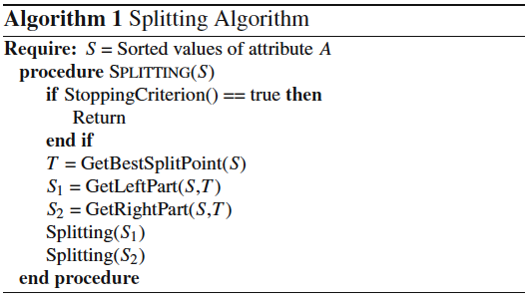
Description of Representative Methods
Splitting

Slide 20

Description of Representative Methods
Splitting
MDLP — This discretizer uses the entropy measure to evaluate candidate cut points. Entropy is one of the most commonly used discretization measures in the literature. The entropy of a sample variable X is
where x represents a value of X and p_{x} its estimated probability of occurring.

Slide 21
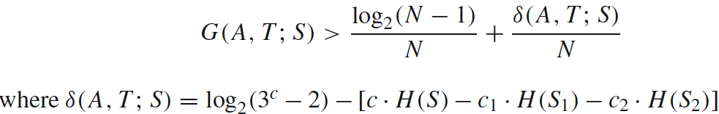
Description of Representative Methods
Splitting
MDLP — Information is high for lower probable events and low otherwise. This discretizer uses the Information Gain of a cut point, which is defined as
where A is the attribute in question, T is a candidate cut point and S is the set of N examples. So, S_{i} is a partitioned subset of examples produced by T. The MDLP discretizer applies the Minimum Description Length Principle to decide the acceptation or rejection for each cut point and to govern the stopping criterion.

Slide 22
Entropy
Very impure group
Less impure
Minimum impurity

Slide 23
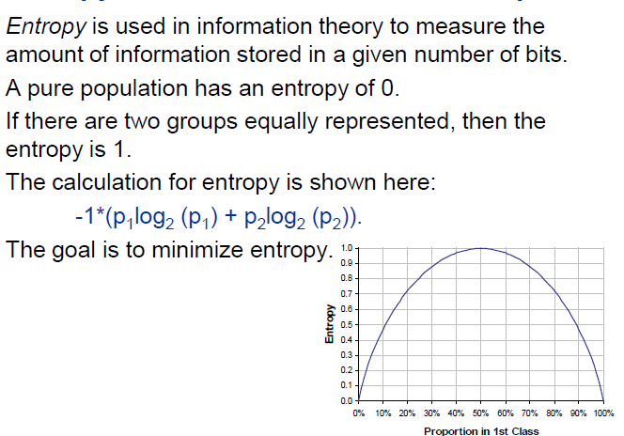
Entropy

Slide 24
Entropy
> proporsi <- prop.table(table(data$class))
> entropy = -proporsi[1] * log(proporsi[1]) - proporsi[2] * log(proporsi[2])
> entropy
0
0.6924521
> library(discretization)
> ent(data$class)
[1] 0.6924521

Slide 25
Information Gain
Mana yang lebih baik?
X < 35 vs X ≥ 35
atau
X < 40 vs X ≥ 40

Slide 26
Information Gain
ent.total <- ent(data$class)
ent.35.1 <- ent(data$class[data$x < 35])
ent.35.2 <- ent(data$class[data$x >= 35])
ent.40.1 <- ent(data$class[data$x < 40])
ent.40.2 <- ent(data$class[data$x >= 40])
ig.35 <- ent.total -
( length(data$class[data$x < 35])/length(data$class) * ent.35.1 +
length(data$class[data$x >= 35])/length(data$class) * ent.35.2)
ig.40 <- ent.total -
( length(data$class[data$x < 40])/length(data$class) * ent.40.1 +
length(data$class[data$x >= 40])/length(data$class) * ent.40.2)
> ig.35
[1] 0.002782724
> ig.40
[1] 0.003429511

Slide 27
> data <- read.csv("D:/disk01.csv", header=TRUE)
> head(data)
x class
1 51 0
2 19 1
3 66 1
4 35 0
5 64 1
6 48 1
>
> library(discretization)
> ##---- MDLP discretization ----
> mdlp <- mdlp(data)
> mdlp$cutp
[[1]]
[1] 29.5 54.5 46.5 64.5

Slide 28
> x.mdlp <- mdlp$Disc.data$x
> table(x.mdlp)
x.mdlp
1 2 3 4 5
344 507 280 315 83

Slide 29
> proporsi <- prop.table(table(x.mdlp, data$class), margin=1)
> barplot(t(proporsi))
>

Slide 30
Hasil Reg Logistik setelah Diskretisasi MDLP
> model.mdlp <- glm(data$class ~ x.mdlp, family="binomial")
> prediksi.prob.mdlp <- predict(model.mdlp, newdata=x.mdlp, type="response")
> prediksi.mdlp <- ifelse(prediksi.prob.mdlp > 0.5, 1, 0)
> table(data$class, prediksi.mdlp)
prediksi.mdlp
0 1
0 578 158
1 209 584
> mean(data$class == prediksi.mdlp)
[1] 0.7599738
Recall… ini akurasi tanpa diskretisasi
0.5434925

Slide 31
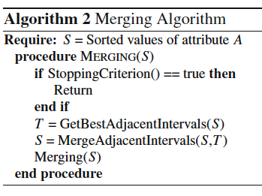
Description of Representative Methods
Merging

Slide 32
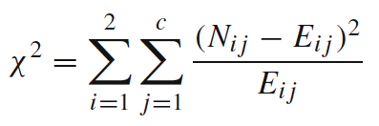
Description of Representative Methods
Merging
ChiMerge — χ² is a statistical measure that conducts a significance test on the relationship between the values of an attribute and the class. This statistic determines the similarity of adjacent intervals based on some significance level. Actually, it tests the hypothesis that two adjacent intervals of an attribute are independent of the class. χ² is computed as:

Slide 33
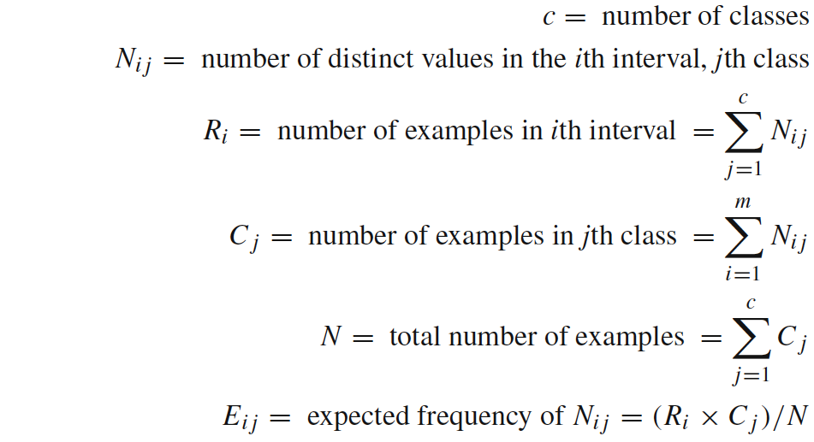
Description of Representative Methods
Merging
ChiMerge —
It is a supervised, bottom-up discretizer. At the beginning, each distinct value of the attribute is considered to be one interval. χ² tests are performed for every pair of adjacent intervals. Those adjacent intervals with the least χ² value are merged until the chosen stopping criterion is satisfied.

Slide 34
> data <- read.csv("D:/disk01.csv", header=TRUE)
> head(data)
x class
1 51 0
2 19 1
3 66 1
4 35 0
5 64 1
6 48 1
> disk.chi <- chiM(data,0.05)
> disk.chi$cutp
[[1]]
[1] 23.5 27.5 30.5 33.5 38.5 40.5 45.5 49.5 54.5 59.5 64.5

Slide 35
> x.chim <- disk.chi$Disc.data$x
> table(x.chim)
x.chim
1 2 3 4 5 6 7 8 9 10 11 12
175 115 87 110 159 45 123 159 158 162 153 83

Slide 36
> proporsi <- prop.table(table(x.chim, data$class), margin=1)
> barplot(t(proporsi))

Slide 37
> model.chi <- glm(data$class ~ as.factor(x.chim), family="binomial")
> prediksi.prob.chi <- predict(model.chi, newdata= as.factor(x.chim), type="response")
> prediksi.chi <- ifelse(prediksi.prob.chi > 0.5, 1, 0)
> table(data$class, prediksi.chi)
prediksi.chi
0 1
0 603 133
1 238 555
> mean(data$class == prediksi.chi)
[1] 0.7573578
Recall… ini akurasi tanpa diskretisasi
0.5434925

Slide 38
terima kasih

